Slide 1
Efficient Use Of Networks Using Network Coding

Slide 2
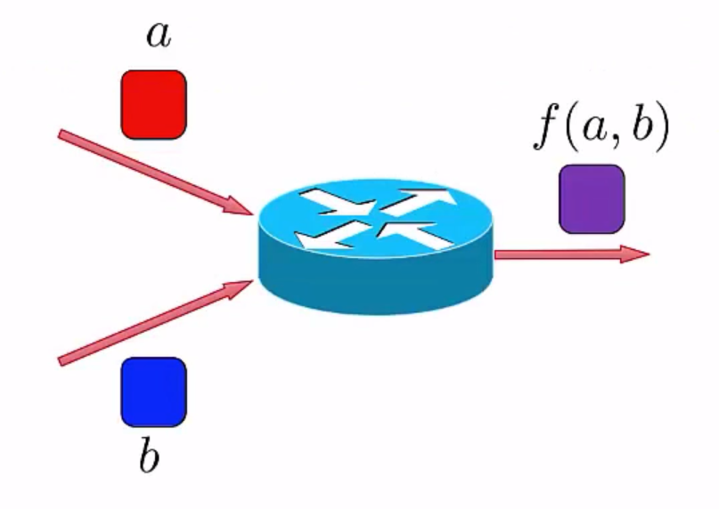
What is Network Coding?
Notes:
It is a fairly new term. It basically refers to combining packets together on the network and forwarding them!

Slide 3
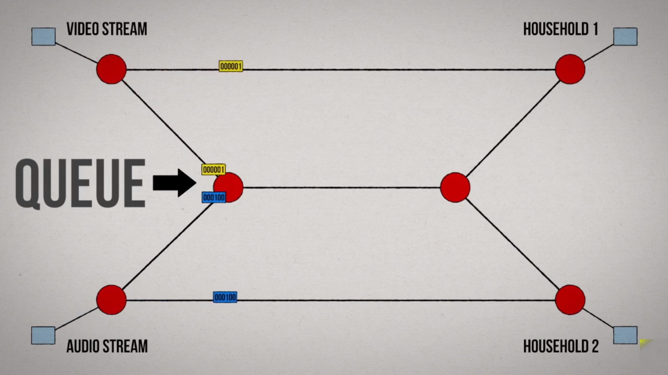

Slide 4
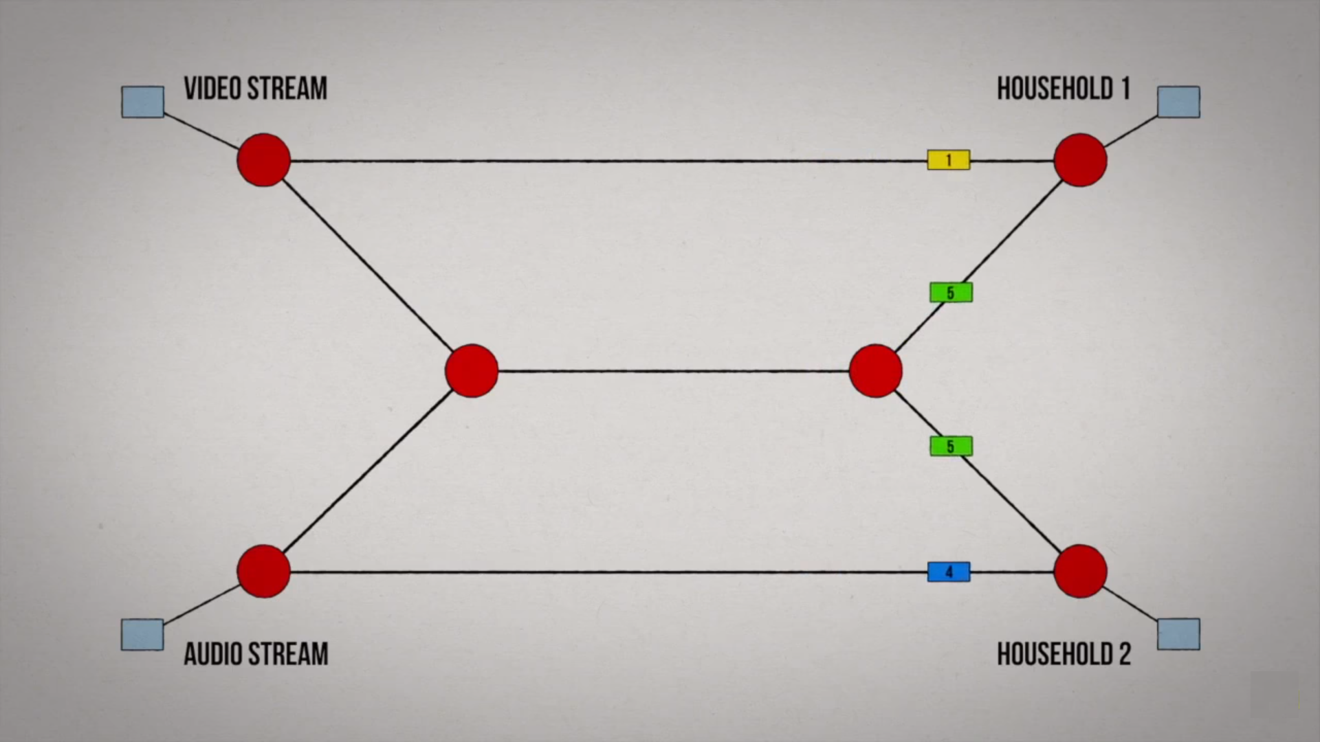

Slide 5
Combine incoming packets into one or many outgoing packets.
Goal
Increase throughput
Decrease Energy Consumption
Decrease Delay/Wait Time
Increase Reliability

Slide 6
Increased Throughput
Increase Information Content Of Transfers And Packets.
Decreases Number Of Transfers To Transfers to Carry Data to Multiple or Single Nodes.
This Makes Bandwidth available for other nodes to use
Delay is reduced drastically.

Slide 7
Flexibility
All packets become equally important as information gets disseminated.
Information can be retrieved by collecting enough number of packets regardless of which packets.

Slide 8
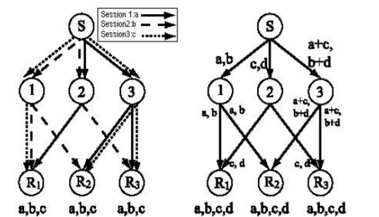
Not only the shortest path is used but also other paths are used to transmit the data.
The traffic in the network is distributed to multiple links and network coding can have an effect of load balancing.

Slide 9
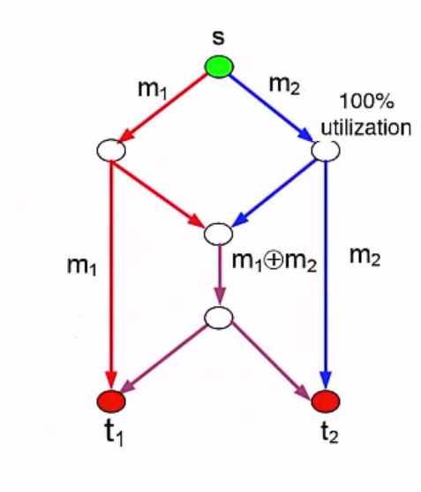
Disadvantages
The loss of one packet could affect many other packets and renders some information useless at the receiver.
Data cannot be recovered until all
the information necessary is received → Delay

Slide 10
Synchronization is a problem that needs to be considered when network coding will be implemented in computer or satellite networks.
It it can be a serious problem for real-time applications (e.g. voice and video transmission).
However, certain types of networks like switching networks are inherently fully synchronized. These types of networks are perfect candidates for the application of network coding.

Slide 11
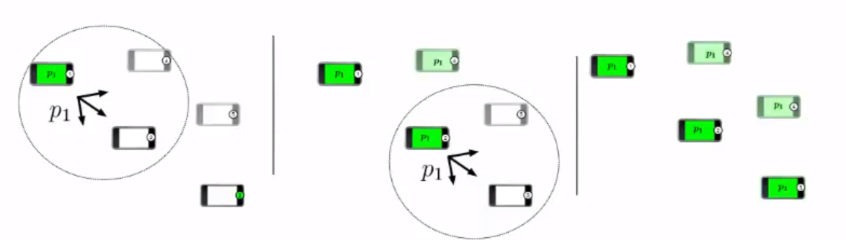
Index Coding
Works on the notion of side information.
Basically, information know to a node but not really required to the node.
This is due to the nature of the broadcast spectrum.

Slide 12
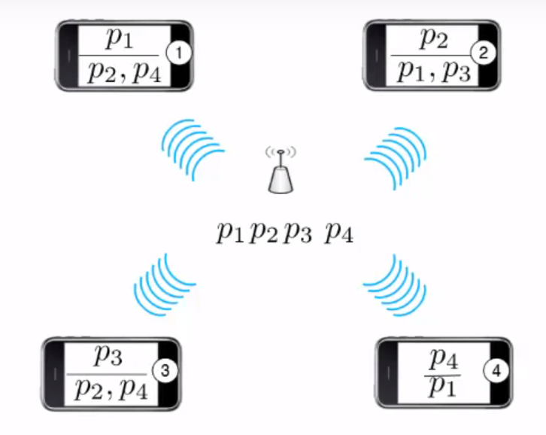

Slide 13
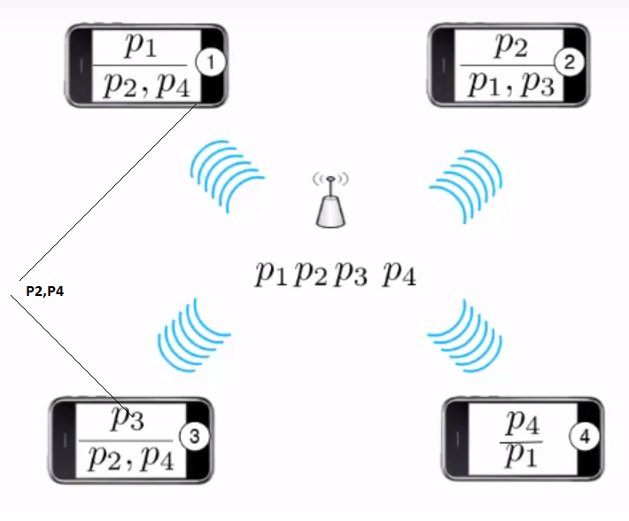

Slide 14
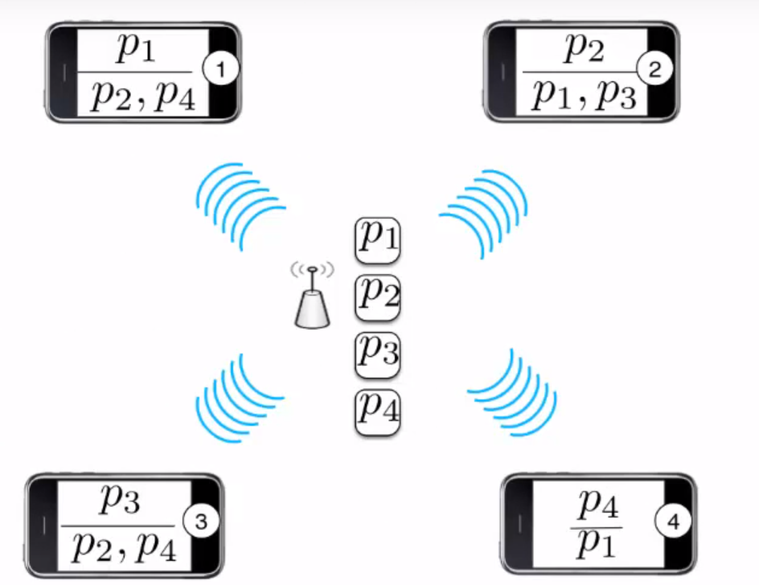

Slide 15
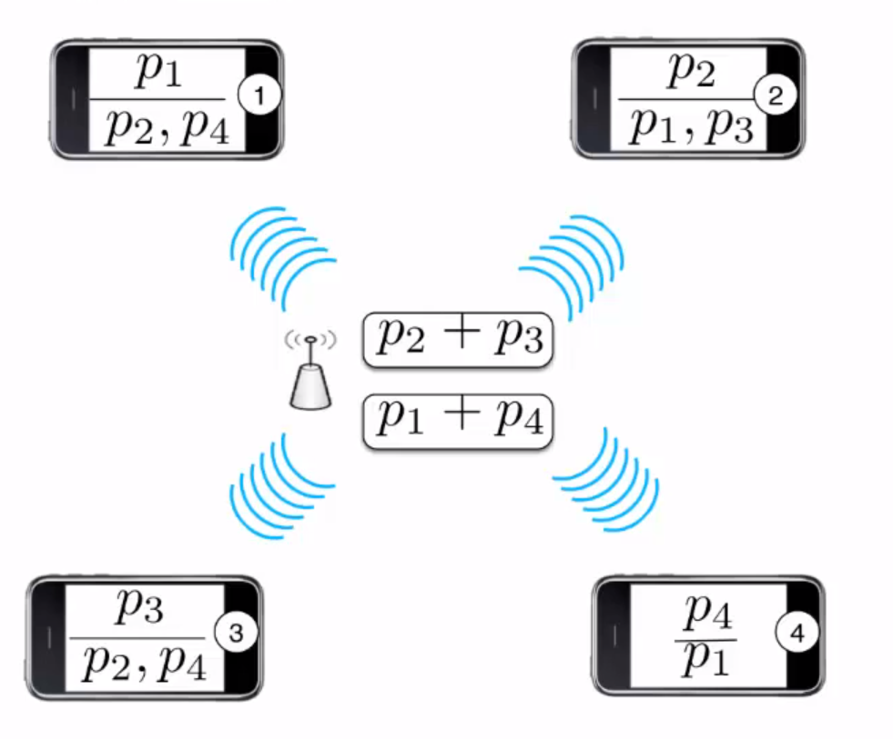

Slide 16
Analog Network Coding
Instead of avoiding interference, we exploit the interference.
Multiple senders transmit simultaneously, the packets collide.
It means that the channel adds their physical signals after applying attenuations and time shifts.
Thus if we know the content of the packet that interfered we can derieve the signal we are interested in.

Slide 17
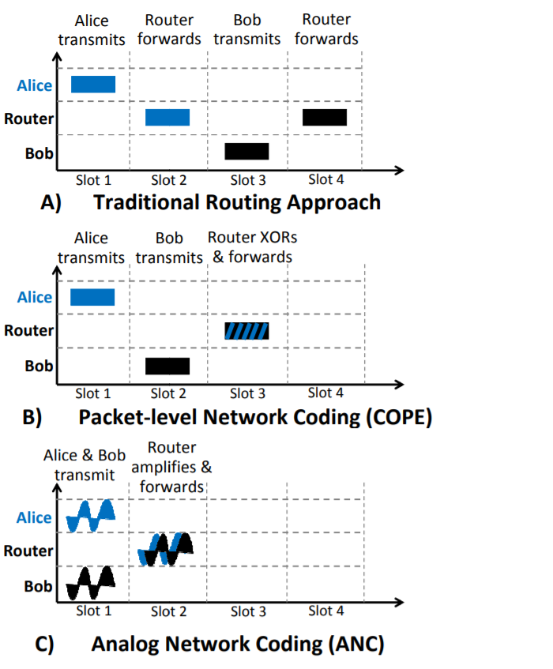

Slide 20
Flooding
Flooding is a simple routing technique in computer networks where a source or node sends packets through every outgoing link.
Flooding, which is similar to broadcasting, occurs when source packets (without routing data) are transmitted to all attached network nodes.
Because flooding uses every path in the network, the shortest path is also used.

Slide 21
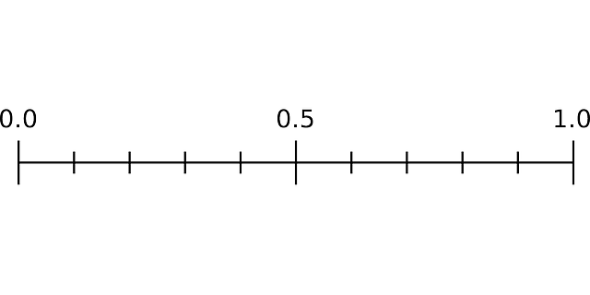

Slide 22
All Static Nodes

Slide 23
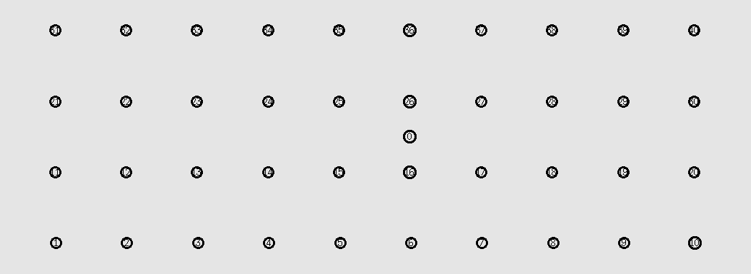
40 Static Nodes
Threshold | Packets in network | Coded Packets | Non-Coded Packets | Destination 1 Unique | Destination 2 Unique | Destination 3 Unique | Ratio
0 | 12974 | 11921 | 763 | 84 | 84 | 84 | 0.776938
0.1 | 12974 | 11921 | 763 | 84 | 84 | 84 | 0.776938
0.2 | 12974 | 11921 | 763 | 84 | 84 | 84 | 0.776938
0.3 | 25507 | 15939 | 9069 | 164 | 164 | 164 | 0.771553
0.4 | 31870 | 5419 | 25902 | 250 | 234 | 250 | 0.921243
0.5 | 32682 | 1621 | 30617 | 250 | 250 | 250 | 0.917936
0.6 | 33908 | 38 | 33119 | 250 | 249 | 250 | 0.883567

Slide 24
40 Static Nodes
Threshold | Packets in network | Coded Packets | Non-Coded Packets | Destination 1 Unique | Destination 2 Unique | Destination 3 Unique | Ratio
0.3 | 25507 | 15939 | 9069 | 164 | 164 | 164 | 0.771553
0.31 | 24987 | 14845 | 9592 | 161 | 159 | 161 | 0.77
0.32 | 24973 | 13882 | 10647 | 161 | 161 | 161 | 0.773636
0.33 | 25837 | 14349 | 11000 | 169 | 169 | 169 | 0.784921
0.34 | 26171 | 13627 | 12107 | 149 | 170 | 149 | 0.715296
0.35 | 30616 | 13893 | 15922 | 222 | 222 | 222 | 0.870133
0.36 | 31987 | 14017 | 17239 | 233 | 240 | 233 | 0.882859
0.37 | 32392 | 12204 | 19464 | 250 | 238 | 250 | 0.911336
0.38 | 31885 | 8397 | 22788 | 250 | 222 | 250 | 0.905755
0.39 | 32274 | 6705 | 24852 | 250 | 238 | 250 | 0.914668
0.4 | 31870 | 5419 | 25902 | 250 | 234 | 250 | 0.921243

Slide 25
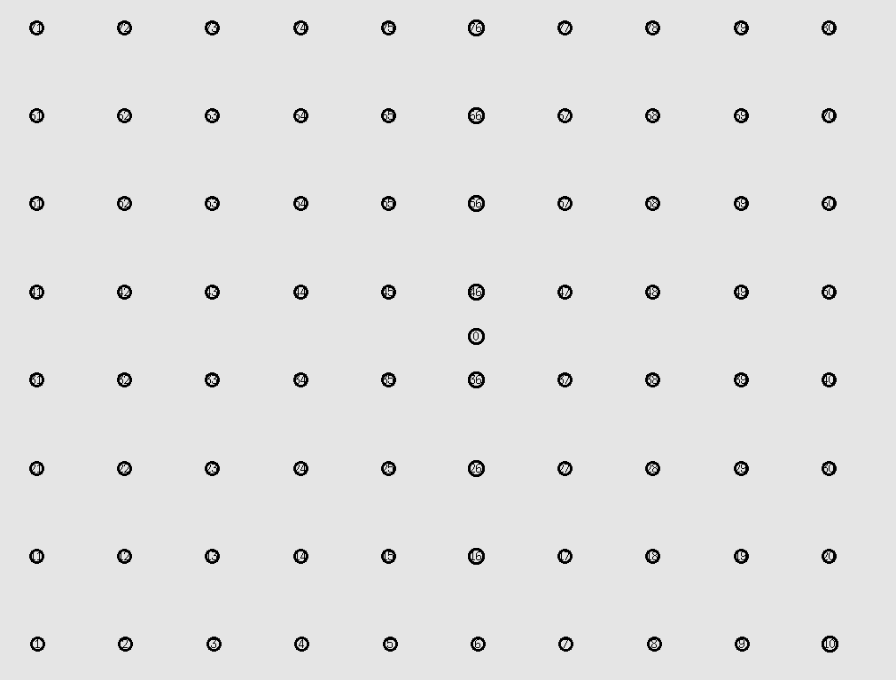
80 Static Nodes
Threshold | Packets in network | Coded Packets | Non-Coded Packets | Destination 1 Unique | Destination 2 Unique | Destination 3 Unique | Ratio
0 | 2053 | 1264 | 787 | 1 | 1 | 1 | 0.116902
0.1 | 2053 | 1264 | 787 | 1 | 1 | 1 | 0.116902
0.2 | 2053 | 1264 | 787 | 1 | 1 | 1 | 0.116902
0.3 | 2354 | 1272 | 1074 | 2 | 2 | 2 | 0.203908
0.4 | 67116 | 12235 | 54254 | 250 | 250 | 250 | 0.893975
0.5 | 67700 | 3645 | 63580 | 250 | 250 | 250 | 0.886263
0.6 | 68877 | 153 | 68043 | 250 | 250 | 250 | 0.871118

Slide 26
80 Static Nodes
Threshold | Packets in network | Coded Packets | Non-Coded Packets | Destination 1 Unique | Destination 2 Unique | Destination 3 Unique | Ratio
0.4 | 31870 | 5419 | 25902 | 250 | 234 | 250 | 0.921243
0.41 | 32088 | 4644 | 26867 | 248 | 235 | 249 | 0.912491
0.42 | 32248 | 4082 | 27604 | 250 | 237 | 250 | 0.914165
0.43 | 32246 | 3396 | 28352 | 250 | 233 | 250 | 0.90926
0.44 | 31926 | 3110 | 28340 | 250 | 233 | 250 | 0.918374
0.45 | 32177 | 2922 | 28810 | 250 | 238 | 250 | 0.917425
0.46 | 32196 | 2616 | 29146 | 250 | 240 | 250 | 0.919369
0.47 | 32127 | 2347 | 29361 | 249 | 242 | 249 | 0.921343
0.48 | 32134 | 2463 | 29271 | 249 | 236 | 249 | 0.913674
0.49 | 32223 | 2142 | 29620 | 249 | 240 | 249 | 0.916116
0.5 | 32682 | 1621 | 30617 | 250 | 250 | 250 | 0.917936

Slide 27
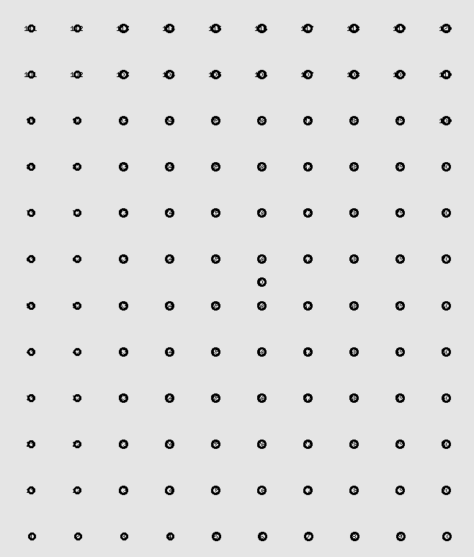
120 Static Nodes
Threshold | Packets in network | Coded Packets | Non-Coded Packets | Destination 1 Unique | Destination 2 Unique | Destination 3 Unique | Ratio
0 | 2208 | 1264 | 942 | 1 | 1 | 1 | 0.163043
0.1 | 2208 | 1264 | 942 | 1 | 1 | 1 | 0.163043
0.2 | 2208 | 1264 | 942 | 1 | 1 | 1 | 0.163043
0.3 | 4887 | 3052 | 1828 | 2 | 2 | 2 | 0.14733
0.4 | 102552 | 20198 | 81752 | 250 | 250 | 250 | 0.877604
0.5 | 102955 | 4890 | 97622 | 250 | 250 | 250 | 0.874168
0.6 | 104396 | 346 | 103349 | 250 | 250 | 250 | 0.862102

Slide 28
120 Static Nodes
Threshold | Packets in network | Coded Packets | Non-Coded Packets | Destination 1 Unique | Destination 2 Unique | Destination 3 Unique | Ratio
0.4 | 102552 | 20198 | 81752 | 250 | 250 | 250 | 0.877604
0.41 | 34699 | 6877 | 27632 | 78 | 78 | 78 | 0.809245
0.42 | 102781 | 13241 | 89072 | 250 | 247 | 250 | 0.872146
0.43 | 102870 | 9939 | 92436 | 250 | 249 | 250 | 0.873724
0.44 | 102448 | 8114 | 93859 | 250 | 248 | 250 | 0.876152
0.45 | 103061 | 9210 | 93360 | 250 | 250 | 250 | 0.873269
0.46 | 102986 | 7772 | 94709 | 250 | 250 | 250 | 0.873905
0.47 | 45084 | 4341 | 40538 | 110 | 109 | 110 | 0.875699
0.48 | 103185 | 6213 | 96558 | 250 | 250 | 250 | 0.87222
0.49 | 102790 | 6462 | 95934 | 250 | 250 | 250 | 0.875572
0.5 | 102955 | 4890 | 97622 | 250 | 250 | 250 | 0.874168

Slide 29
Few Nodes Moving

Slide 30
40 Nodes
Threshold | Packets in network | Coded Packets | Non-Coded Packets | Destination 1 Unique | Destination 2 Unique | Destination 3 Unique | Ratio
0 | 8213 | 6627 | 1505 | 26 | 26 | 26 | 0.379886
0.1 | 8338 | 6750 | 1509 | 26 | 26 | 26 | 0.37419
0.2 | 8149 | 6569 | 1515 | 24 | 24 | 24 | 0.353418
0.3 | 5801 | 3073 | 2725 | 2 | 2 | 2 | 0.041372
0.4 | 7756 | 1711 | 5945 | 24 | 24 | 24 | 0.371325
0.5 | 12200 | 1101 | 10946 | 64 | 63 | 64 | 0.62623
0.6 | 12584 | 50 | 12354 | 64 | 64 | 64 | 0.610299

Slide 31
40 Nodes
Threshold | Packets in network | Coded Packets | Non-Coded Packets | Destination 1 Unique | Destination 2 Unique | Destination 3 Unique | Ratio
0.3 | 5801 | 3073 | 2725 | 2 | 2 | 2 | 0.041372
0.31 | 4648 | 2692 | 1956 | 2 | 2 | 2 | 0.051635
0.32 | 5237 | 2067 | 3167 | 2 | 2 | 2 | 0.045828
0.33 | 4881 | 1713 | 3166 | 2 | 2 | 2 | 0.04917
0.34 | 5294 | 1684 | 3607 | 2 | 2 | 2 | 0.045334
0.35 | 5175 | 1577 | 3594 | 2 | 2 | 2 | 0.046377
0.36 | 5632 | 1595 | 4033 | 2 | 2 | 2 | 0.042614
0.37 | 7246 | 2374 | 4783 | 23 | 23 | 23 | 0.3809
0.38 | 7924 | 2361 | 5467 | 26 | 26 | 26 | 0.393741
0.39 | 7818 | 1900 | 5820 | 22 | 26 | 22 | 0.358148
0.4 | 7756 | 1711 | 5945 | 24 | 24 | 24 | 0.371325

Slide 32
80 Nodes
Threshold | Packets in network | Coded Packets | Non-Coded Packets | Destination 1 Unique | Destination 2 Unique | Destination 3 Unique | Ratio
0 | 10705 | 8865 | 1788 | 21 | 21 | 21 | 0.470808
0.1 | 10728 | 8900 | 1776 | 21 | 21 | 21 | 0.469799
0.2 | 10728 | 8820 | 1816 | 21 | 21 | 21 | 0.469799
0.3 | 6106 | 3129 | 2975 | 2 | 2 | 2 | 0.078611
0.4 | 19324 | 3533 | 15654 | 58 | 57 | 58 | 0.716208
0.5 | 19844 | 749 | 18997 | 58 | 59 | 58 | 0.705503
0.6 | 20219 | 29 | 20039 | 59 | 59 | 59 | 0.700331

Slide 33
80 Nodes
Threshold | Packets in network | Coded Packets | Non-Coded Packets | Destination 1 Unique | Destination 2 Unique | Destination 3 Unique | Ratio
0.3 | 6106 | 3129 | 2975 | 2 | 2 | 2 | 0.078611
0.31 | 5577 | 2463 | 3112 | 2 | 2 | 2 | 0.086068
0.32 | 5751 | 2709 | 3040 | 2 | 2 | 2 | 0.083464
0.33 | 5926 | 2356 | 3568 | 2 | 2 | 2 | 0.080999
0.34 | 5908 | 2199 | 3707 | 2 | 2 | 2 | 0.081246
0.35 | 5912 | 1868 | 4042 | 2 | 2 | 2 | 0.081191
0.36 | 5578 | 1471 | 4104 | 2 | 2 | 2 | 0.086052
0.37 | 18572 | 7901 | 10505 | 48 | 53 | 53 | 0.663364
0.38 | 19034 | 5570 | 13310 | 54 | 55 | 56 | 0.693496
0.39 | 18663 | 6157 | 12290 | 59 | 59 | 58 | 0.754434
0.4 | 19324 | 3533 | 15654 | 58 | 57 | 58 | 0.716208

Slide 34
120 Nodes
Threshold | Packets in network | Coded Packets | Non-Coded Packets | Destination 1 Unique | Destination 2 Unique | Destination 3 Unique | Ratio
0 | 8213 | 6627 | 1505 | 26 | 26 | 26 | 0.379886
0.1 | 8338 | 6750 | 1509 | 26 | 26 | 26 | 0.37419
0.2 | 8149 | 6569 | 1515 | 24 | 24 | 24 | 0.353418
0.3 | 5801 | 3073 | 2725 | 2 | 2 | 2 | 0.041372
0.4 | 7756 | 1711 | 5945 | 24 | 24 | 24 | 0.371325
0.5 | 12200 | 1101 | 10946 | 64 | 63 | 64 | 0.62623
0.6 | 12584 | 50 | 12354 | 64 | 64 | 64 | 0.610299

Slide 35
120 Nodes
Threshold | Packets in network | Coded Packets | Non-Coded Packets | Destination 1 Unique | Destination 2 Unique | Destination 3 Unique | Ratio
0.4 | 12626 | 3080 | 9465 | 23 | 14 | 17 | 0.513227
0.41 | 30049 | 5554 | 24294 | 68 | 61 | 64 | 0.770741
0.42 | 31828 | 4472 | 27220 | 70 | 70 | 70 | 0.791756
0.43 | 31887 | 4228 | 27521 | 70 | 70 | 70 | 0.790291
0.44 | 31798 | 3530 | 28157 | 70 | 70 | 70 | 0.792503
0.45 | 32257 | 2723 | 29380 | 70 | 71 | 71 | 0.788666
0.46 | 31778 | 3002 | 28657 | 69 | 70 | 70 | 0.789225
0.47 | 32212 | 2243 | 29838 | 71 | 71 | 70 | 0.789768
0.48 | 31880 | 2130 | 29633 | 69 | 70 | 70 | 0.7867
0.49 | 32395 | 1998 | 30281 | 71 | 71 | 71 | 0.789011
0.5 | 31877 | 1870 | 29891 | 70 | 70 | 69 | 0.786774

Slide 36
Increase In Range

Slide 37
40 moving nodes
72 vs 80
Threshold | Packets in network | Coded Packets | Non-Coded Packets | Destination 1 Unique | Destination 2 Unique | Destination 3 Unique | Ratio
0 | 8213 | 6627 | 1505 | 26 | 26 | 26 | 0.379886
0.1 | 8338 | 6750 | 1509 | 26 | 26 | 26 | 0.37419
0.2 | 8149 | 6569 | 1515 | 24 | 24 | 24 | 0.353418
0.3 | 5801 | 3073 | 2725 | 2 | 2 | 2 | 0.041372
0.4 | 7756 | 1711 | 5945 | 24 | 24 | 24 | 0.371325
0.5 | 12200 | 1101 | 10946 | 64 | 63 | 64 | 0.62623
0.6 | 12584 | 50 | 12354 | 64 | 64 | 64 | 0.610299
Threshold | Packets in network | Coded Packets | Non-Coded Packets | Destination 1 Unique | Destination 2 Unique | Destination 3 Unique | Ratio
0 | 17971 | 15957 | 1768 | 24 | 152 | 25 | 0.447387
0.1 | 17971 | 15957 | 1768 | 24 | 152 | 25 | 0.447387
0.2 | 13069 | 10911 | 2048 | 15 | 85 | 15 | 0.351978
0.3 | 18607 | 10445 | 7910 | 107 | 12 | 109 | 0.490138
0.4 | 25470 | 6218 | 18871 | 167 | 186 | 167 | 0.816647
0.5 | 28646 | 3168 | 25068 | 202 | 212 | 202 | 0.860155
0.6 | 33947 | 62 | 33118 | 249 | 249 | 249 | 0.880196

Slide 38
72 vs 80
Threshold | Packets in network | Coded Packets | Non-Coded Packets | Destination 1 Unique | Destination 2 Unique | Destination 3 Unique | Ratio
0.3 | 5801 | 3073 | 2725 | 2 | 2 | 2 | 0.041372
0.31 | 4648 | 2692 | 1956 | 2 | 2 | 2 | 0.051635
0.32 | 5237 | 2067 | 3167 | 2 | 2 | 2 | 0.045828
0.33 | 4881 | 1713 | 3166 | 2 | 2 | 2 | 0.04917
0.34 | 5294 | 1684 | 3607 | 2 | 2 | 2 | 0.045334
0.35 | 5175 | 1577 | 3594 | 2 | 2 | 2 | 0.046377
0.36 | 5632 | 1595 | 4033 | 2 | 2 | 2 | 0.042614
0.37 | 7246 | 2374 | 4783 | 23 | 23 | 23 | 0.3809
0.38 | 7924 | 2361 | 5467 | 26 | 26 | 26 | 0.393741
0.39 | 7818 | 1900 | 5820 | 22 | 26 | 22 | 0.358148
0.4 | 7756 | 1711 | 5945 | 24 | 24 | 24 | 0.371325
Threshold | Packets in network | Coded Packets | Non-Coded Packets | Destination 1 Unique | Destination 2 Unique | Destination 3 Unique | Ratio
0.3 | 18607 | 10445 | 7910 | 107 | 12 | 109 | 0.490138
0.31 | 19199 | 10450 | 8428 | 98 | 66 | 97 | 0.543778
0.32 | 21712 | 11914 | 9462 | 143 | 74 | 142 | 0.661385
0.33 | 22789 | 11818 | 10618 | 107 | 133 | 105 | 0.605555
0.34 | 25751 | 12667 | 12518 | 190 | 154 | 190 | 0.829482
0.35 | 26583 | 13214 | 12853 | 184 | 173 | 184 | 0.814054
0.36 | 23479 | 9695 | 13387 | 150 | 140 | 152 | 0.753013
0.37 | 26761 | 11296 | 14922 | 163 | 201 | 163 | 0.787713
0.38 | 26315 | 8849 | 16954 | 169 | 190 | 169 | 0.802584
0.39 | 24881 | 6735 | 17669 | 179 | 158 | 179 | 0.829549
0.4 | 25470 | 6218 | 18871 | 167 | 186 | 167 | 0.816647

Slide 39
Applications!

Slide 40
P2P Networks
A server distributes a ﬁle by breaking it down into small blocks.
Clients in turns, download those small blocks from the server and distribute them among their neighbors.
Network coding has been used in a P2P prototype called Avalanche developed by Microsoft where the blocks sent by servers and clients are random combinations of original blocks.

Slide 41
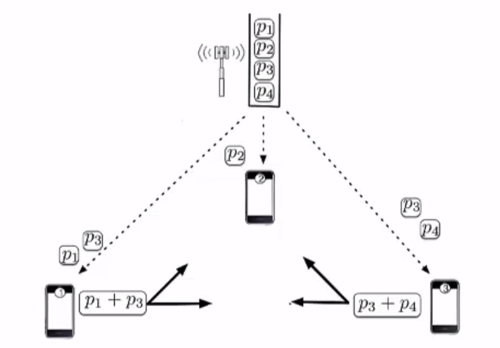
P2P Networks
Server divides files into smaller blocks. (B1,B2,B3,B4,…,Bn.)
Client now receives a linear combination of these blocks.
A coeﬃcient vector u is sent for the client to be able to decode the original blocks.

Slide 42
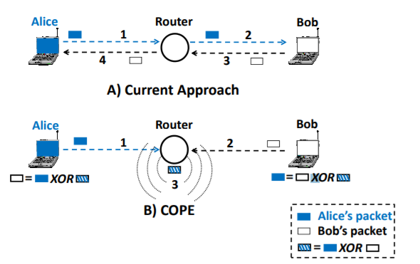
COPE: Packet-level Network Coding
It takes advantage of the broadcast nature of the wireless medium, which allow multiple nearby nodes to overhear a packet when it is broadcast from a node.

Slide 43
Network Coding In security
Network coding has been shown to improve security against many types of attacks including: eavesdropping, modifying data, and jamming attack.
Data does not exist on one node but rather is distributed, overhearing data packets will not result in getting the information except by getting all the required blocks which makes it harder for the eavesdropper
Due to data distribution we can know any piece that was changed, which prevents against modification attacks.

Slide 44
Conclusion
Network Coding is a new and promising area which is based on computer and communication network problems.
Using network coding could help improve performance of a networks by exploiting current infrastructure.
Compared to traditional routing, Network Coding offers more benefits with respect to resource, efficiency and robustness.

Slide 45

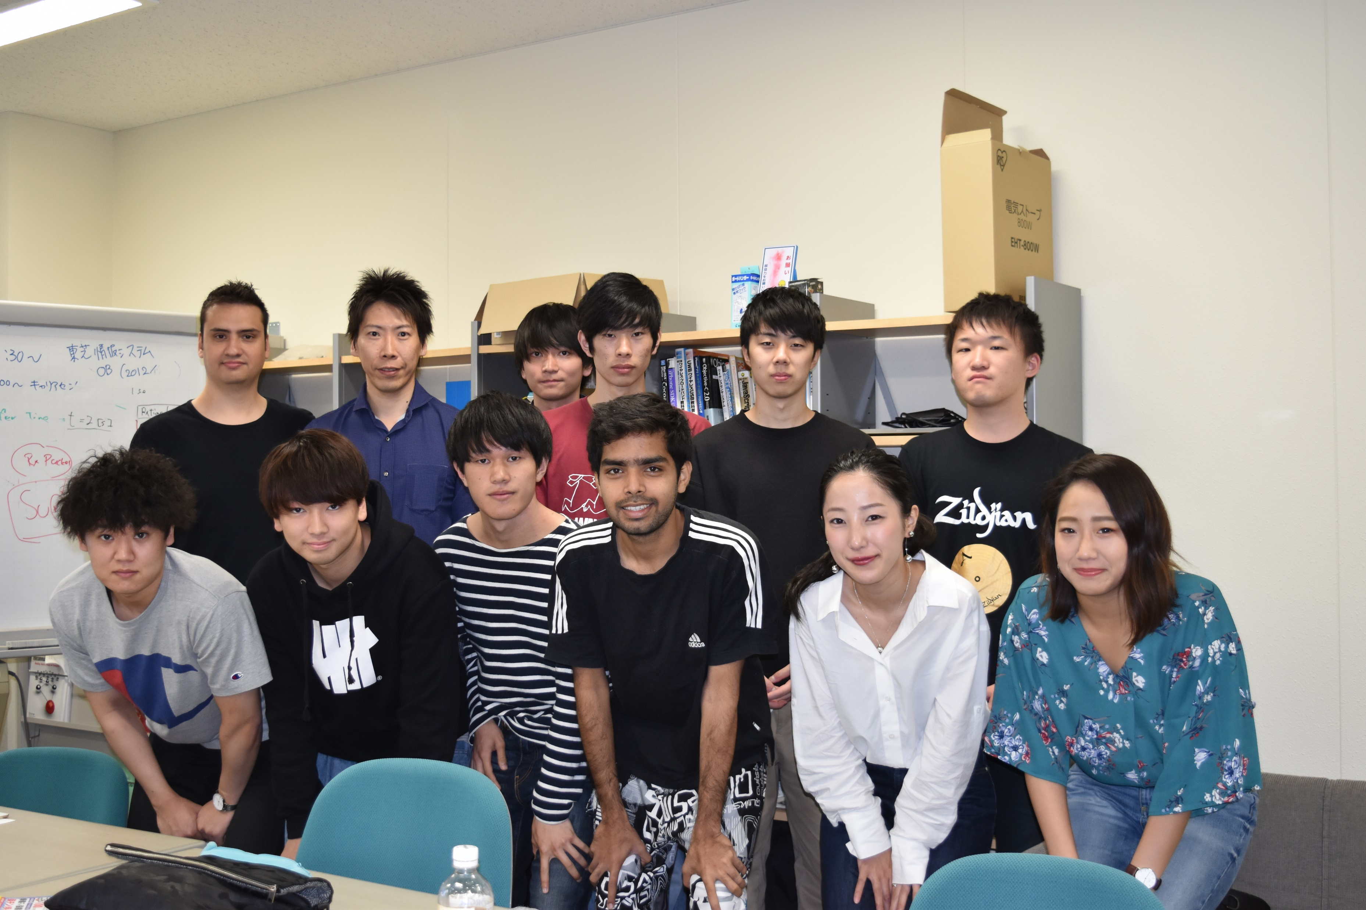

How Did I Enjoy Japan?

Slide 46


Slide 47


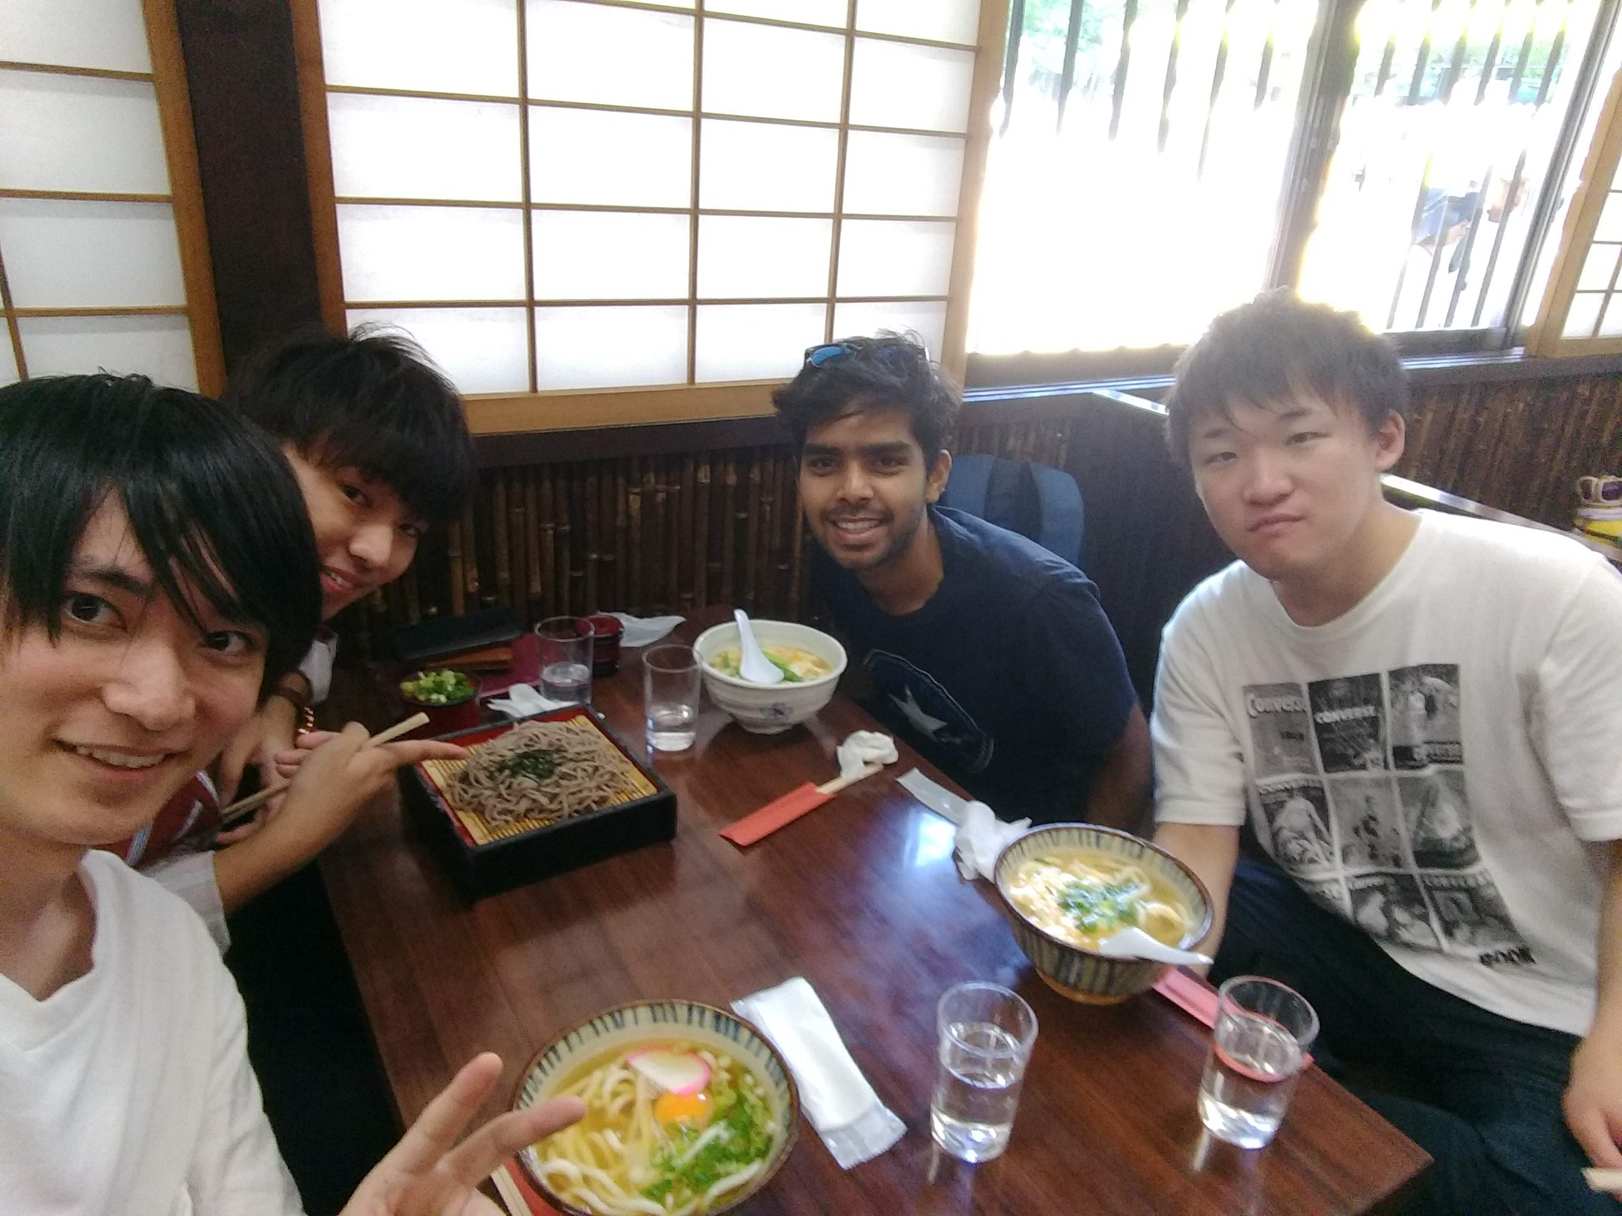



Thank You

